Slide 1


Power Query Table Functions Part 3

Slide 2
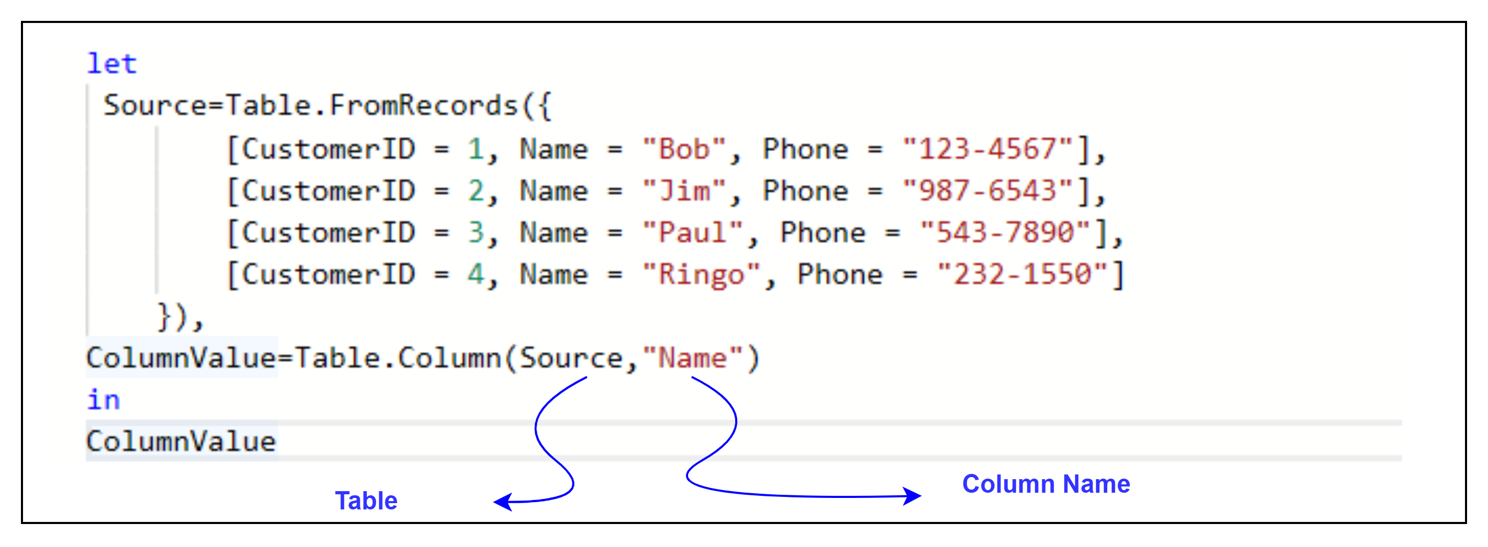
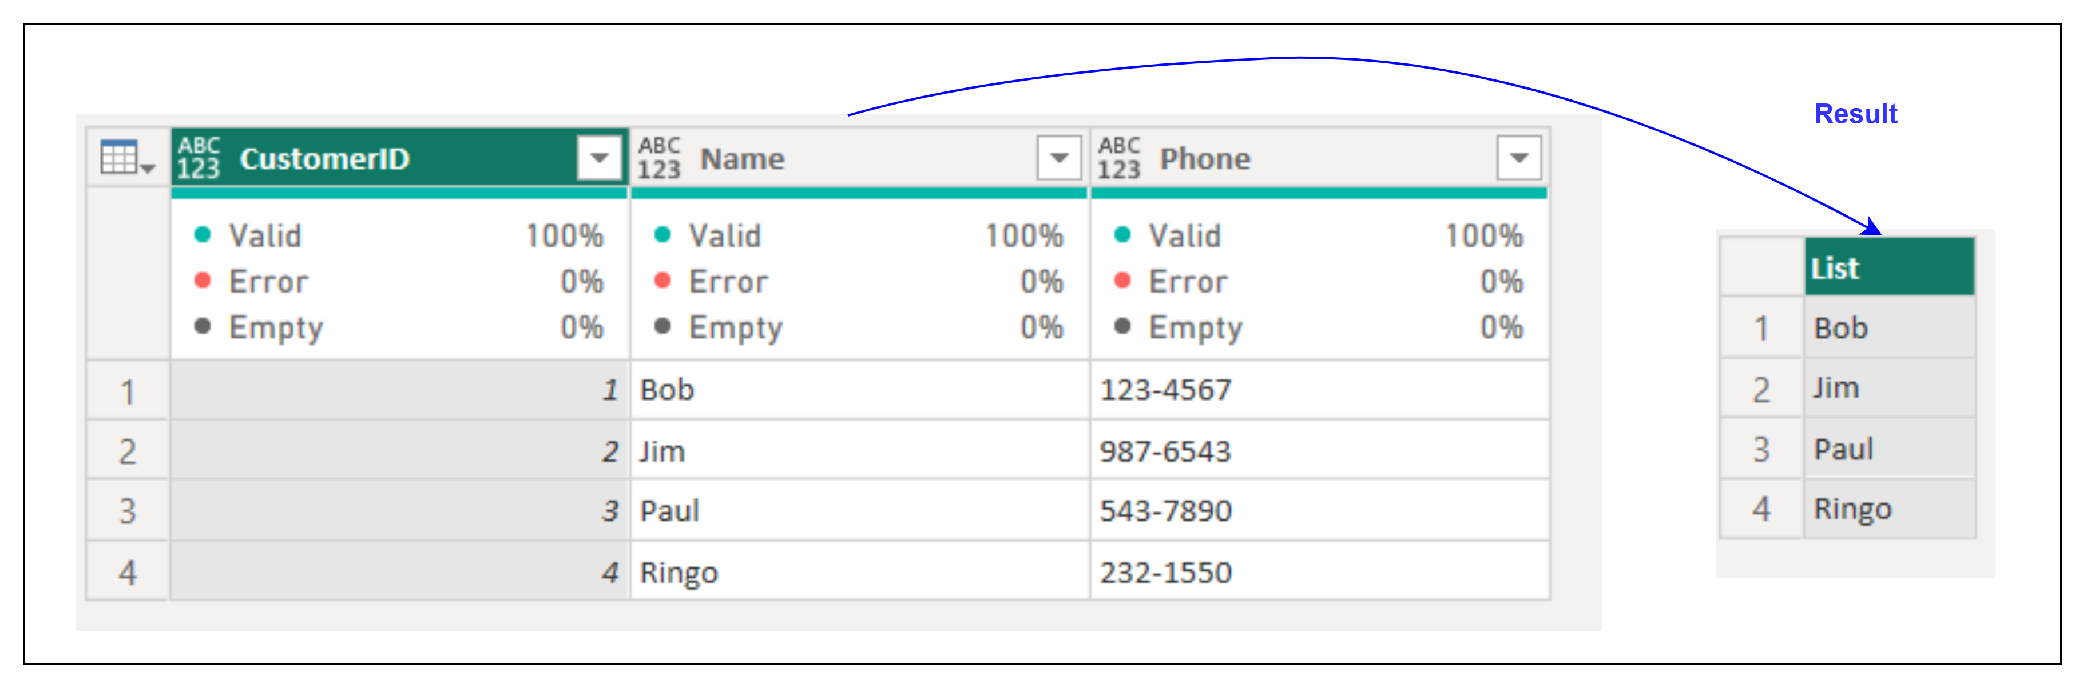
1. Table.Column
Description: Returns the column of data specified by column from the table as a list.
Example:
Result:
Use Cases:
Extracting column values for calculations.
Transforming column data into lists.

Slide 3
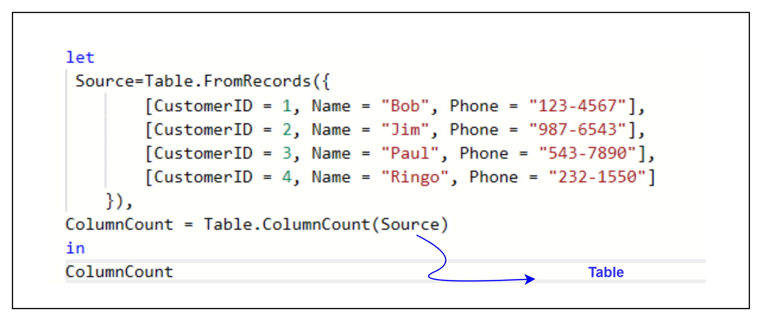
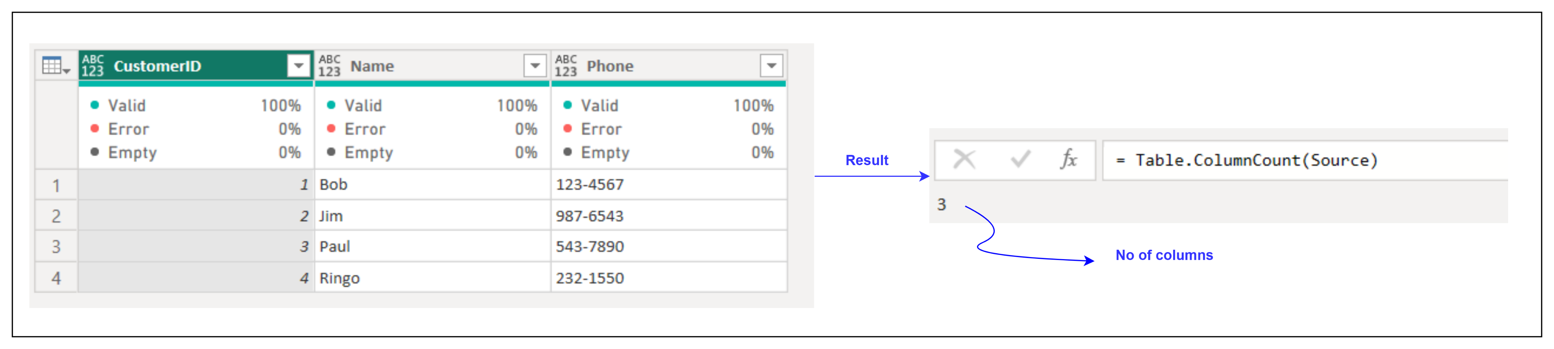
2. Table.ColumnCount
Description: Returns the number of columns in a table.
Example:
Result:
Use Cases:
Metadata analysis of tables.
Validating table structures.

Slide 4
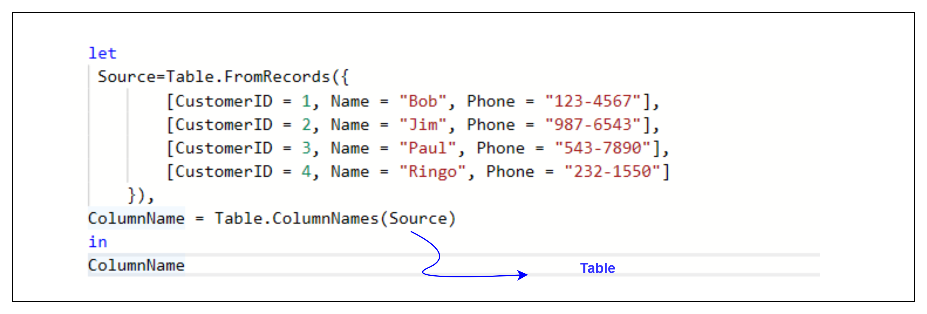
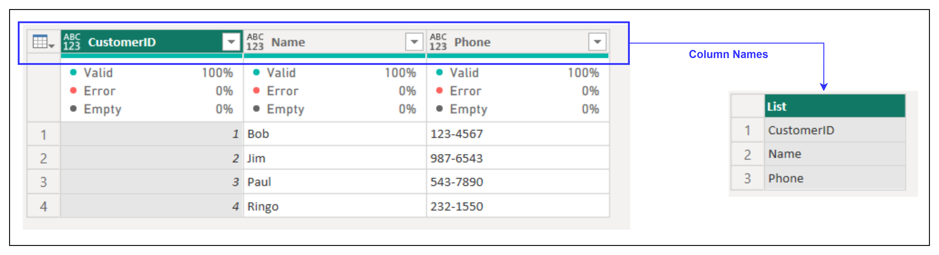
3. Table.ColumnNames
Description: Returns a list of column names from the specified table.
Example:
Result:
Use Cases:
Dynamically retrieving column names for iteration or validation.
Writing generic functions for tables with varying structures.

Slide 5
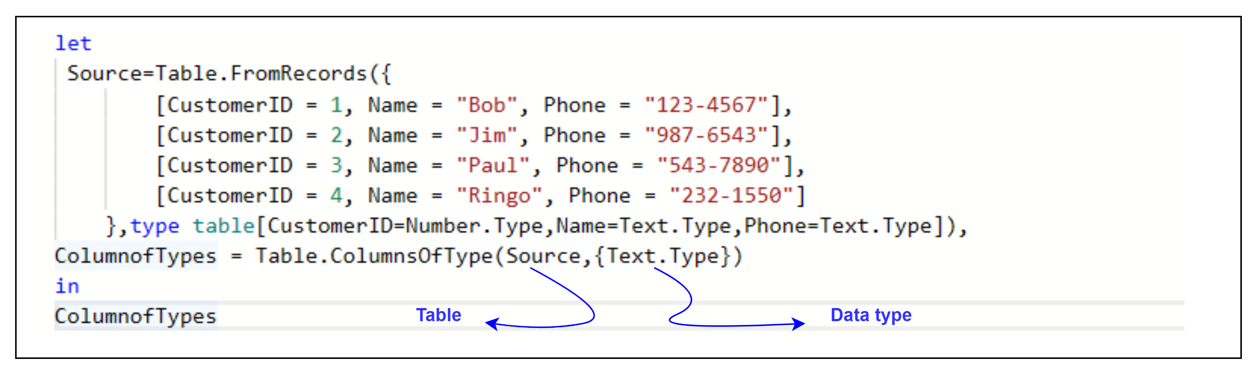
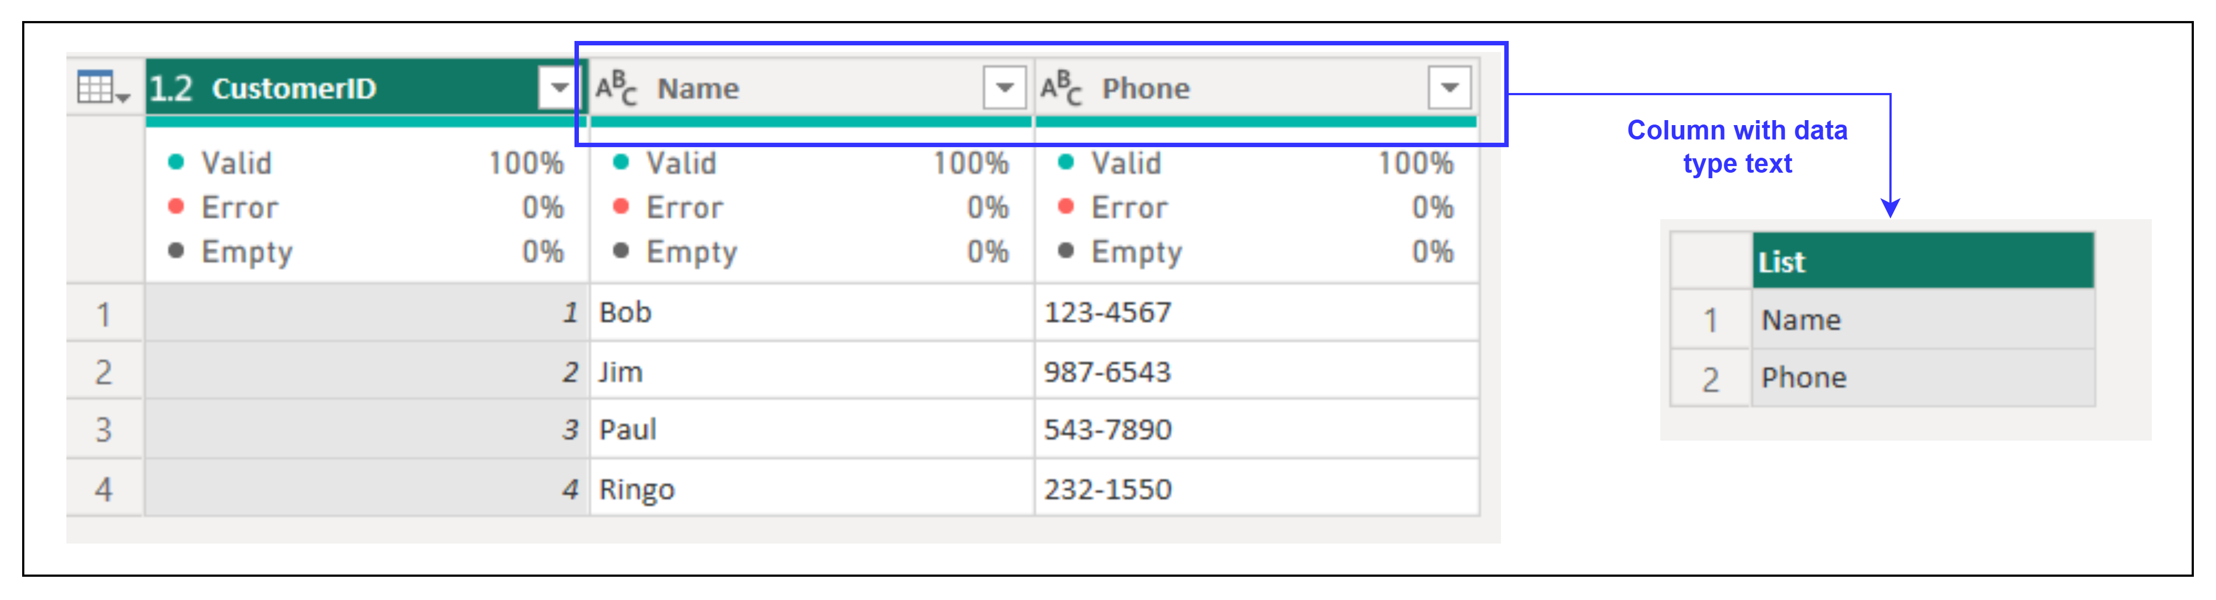
4. Table.ColumnsOfType
Description: Returns a list with the names of the columns from table table that match the types specified .
Example:
Result:
Use Cases:
Filtering columns by type (e.g., numeric columns for calculations).
Preparing data for specific transformations or validations.

